Slide 1


Introduction to R
Omid Ghasemi, Mahdi Mazidi

Slide 2
What is R?
R is a language and environment for statistical computing and graphical representation of data.
R provides a wide variety of statistical (linear and nonlinear modelling, classical statistical tests, time-series analysis etc…) and graphical techniques, and is highly extensible.

Slide 3
What is RStudio?
RStudio is actually an add-on to R that takes the R software and adds to it a very user-friendly graphical interface.
R may be used without RStudio, but RStudio may not be used without R.
Notes:
Thus, when one uses RStudio, they are still using the full version of R while also getting the benefit of greater functionality and usability due to an improved user interface. As a result, when using R, one should always use RStudio; working with R itself is very cumbersome.
On your computer, you will see R and RStudio as separate installed programs. When using R for data analysis, you will always open and work in RStudio; you must leave R isntalled on the computer for RStudio to work, even though you will likely never open R itself.

Slide 4
Pros and Cons of R
1. State of the art (open source, continuously growing)
2. Exemplary Support for Data Wrangling
3. Becoming increasingly popular
4. The Array of Packages
5. Quality Plotting and Graphing
6. Highly Compatible
7. Eye-Catching Reports (Markdown and Shiny)
8. Highly reproducible (especially helpful for open science)
Notes:
R provides exemplary support for data wrangling. The packages like dplyr, readr are capable of transforming messy data into a structured form.
R has a vast array of packages. With over 10,000 packages in the CRAN repository, the number is constantly growing. These packages appeal to all the areas of industry.
R is highly compatible and can be paired with many other programming languages like C, C++, Java, and Python. It can also be integrated with technologies like Hadoop and various other database management systems as well.
With packages like Shiny and Markdown, reporting the results of an analysis is extremely easy with R. You can make reports with the data, plots and R scripts embedded in them. You can even make interactive web apps that allow the user to play with the results and the data.
R is a constantly evolving programming language. It is a state of the art technology that provides updates whenever any new feature is added.
Basically, it is most comprehensive statistical analysis package. As new technology and ideas often appear first in R.

Slide 5
Pros and Cons of R
A bit steep learning curve
Lesser Speed in executing complex codes
Spread Across various Packages
In R, quality of some packages is less than perfect.
Note: R is a continuously evolving language. This means that many of the cons will gradually fade away with the future updates of R.
Notes:
The algorithms in R are spread across different packages. Programmers without prior knowledge of packages may find it difficult to implement algorithms.

Slide 6
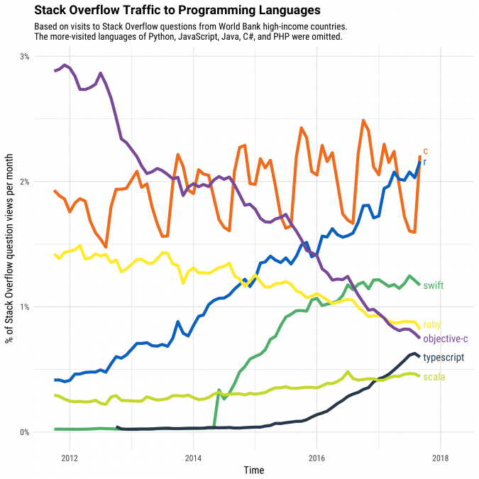
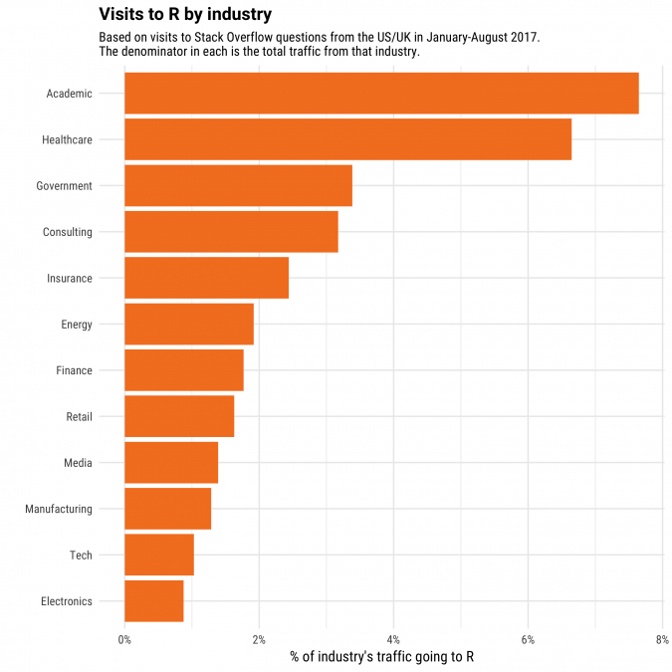
Increasing Popularity

Slide 7
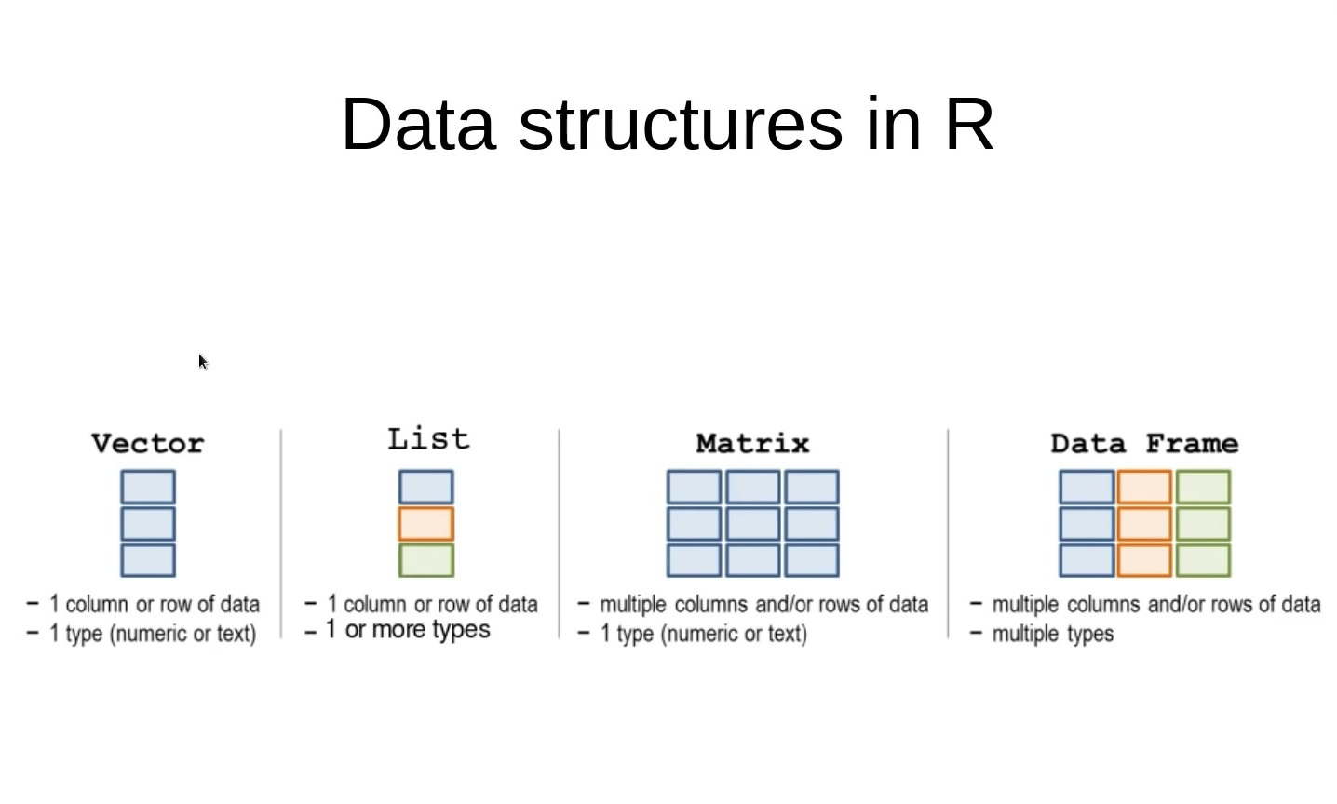

Slide 8
